Slide 1
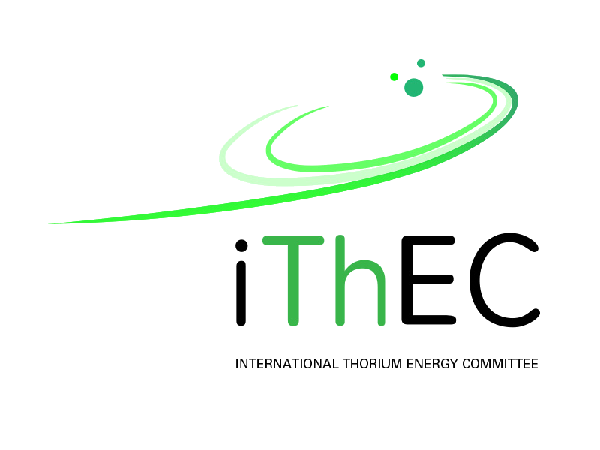

iThEC’s contributions to
the exploitation of thorium
Jean-Pierre Revol
www.ithec.org
5th International Workshop on
ACCELERATOR-DRIVEN SUB-CRITICAL SYSTEMS & THORIUM UTILIZATION
SCK•CEN, November 6-8, 2019

Slide 2
iThEC’s goals
Promote research and development in thorium technologies, with the more specific initial goal of transmuting nuclear waste in accelerator-driven systems (ADS), and the longer-term goal of exploiting thorium as a sustainable source of energy
General agreement that nuclear waste is an issue, even for countries phasing out nuclear energy, so this is our first priority
“Thorium is a source of energy essentially sustainable on the human time scale”
Carlo Rubbia, A future for thorium power?, ThEC13, Oct. 2013
iThEC supports fully the efforts on ADS world-wide especially MYRRHA, but also ADANES and projects in Japan, USA, Russia
Notes:
MYRRHA MUST NOT FAIL !!
Accelerator Driven Advanced Energy System (ADANES)
China Initiative Accelerator Driven System (CiADS)

Slide 3
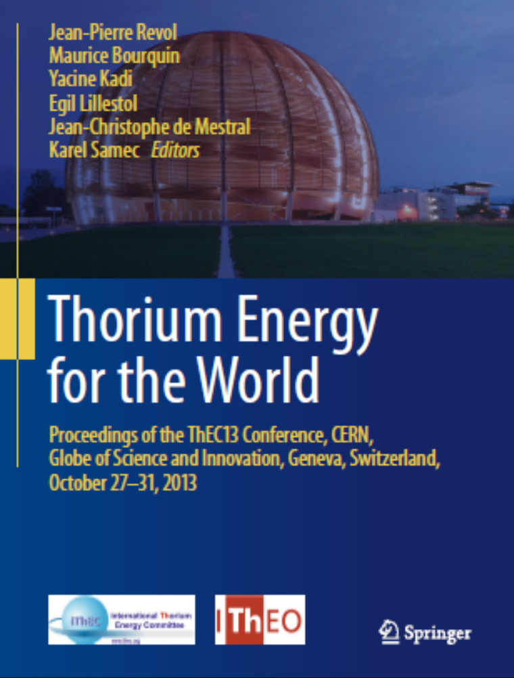
iThEC’s initiatives
ThEC13 ADS Conference: review the status of the field, CERN 2013
CYCLADS proposal, submitted to EU FET H2020, 2018
EURATOM proposal, NFRP-05: Support for safety research of Small
Modular Reactors, 2019
Letter of Intent for an ADS experiment at Troitsk under discussion in Russia
Promotion of ADS at government level in Europe, Switzerland, Russian Federation
  iThEC invited to WEF at Tianjin China, 2018 (Disrupting Energy Technology session),
  WEF Annual Meeting of the New Champions, Tianjin, People's Republic of China, 18–20 Sept. 2018) – iThEC member on WEF Global Future Council on Energy Technologies
  Members of iThEC asked to deliver a report on thorium to the Swiss government
  Many seminars and participations in conferences
98.8k downloads on November 5
Notes:
Future and Emerging Technologies (FET)
Horizon 2020

Slide 4
Political “climate” change
Opposition to deep storage of nuclear waste in France*, Switzerland, USA, etc.
⇒ Need for an alternative
The young generation is worried about climate change,
but no credible solution in sight!
⇒ Developing ADS for nuclear waste transmutation will open the possibility of energy production based on thorium
* Cigéo, Bure, France: ”Do not leave nuclear waste management to future generations”
Notes:
70% of the people interrogated in France by BTV believe that NPP contribute to the climate change

Slide 5
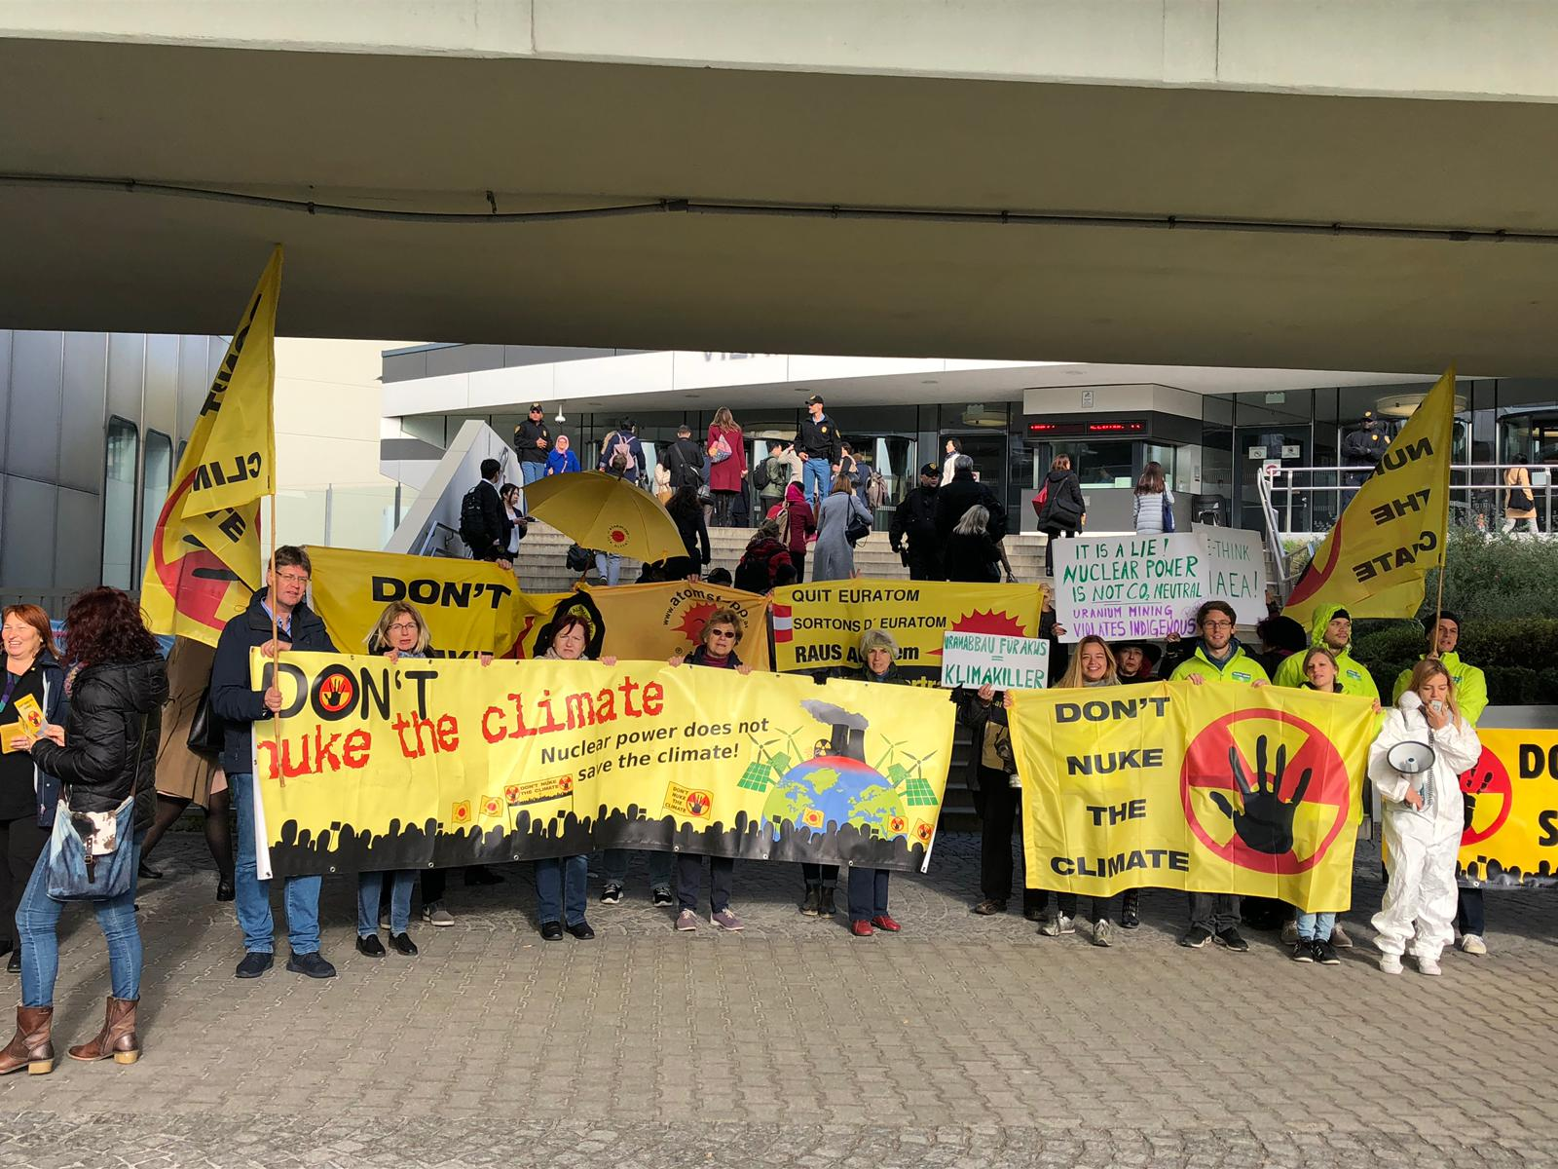
International Conference on Climate Change and the Role of Nuclear Power organized by the International Atomic Energy Agency (IAEA); 7–11 October 2019, Vienna, Austria
Confusion in public* and political circles
* 69 % of people interrogated in France by BVA believe that NPP contribute to climate change

Slide 6
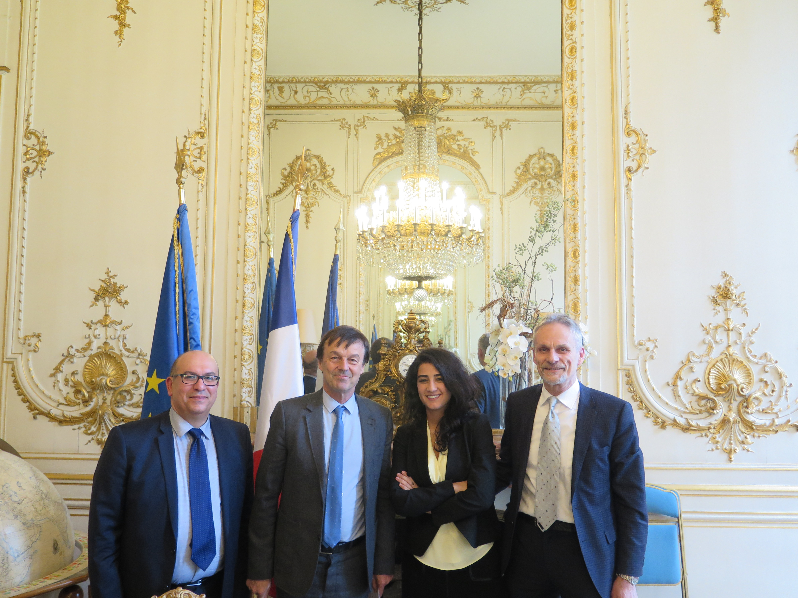
Politicians
Politician lack of understanding
“The French CEA tells me that what you propose does not work! ”
N. Hulot
April 5, 2018

Slide 7
Scientist’s responsibility
There is a need for information among young people (18-34: 86%)
Address young generations in order to trigger their interest and use their enthusiasm
  Nuclear energy can be exploited in a different and better way
  Encourage science education, become an engineer, a researcher* in physics, chemistry, biology, etc., in order to invent solutions through innovation
Politicians can’t invent solutions
  Their role is to make choices
  Scientists must provide them with options
  This makes a project like MYRRHA extremely important
* In the new EU Commission the areas of education and research are not explicitly represented anymore
and instead are included under the ”Innovation and Youth" title: Mariya Gabriel, Bulgarian, Innovation and Youth
Notes:
Le sondage BVA révèle que 86 % des 18-34 ans interrogés, bref, l'immense majorité, en sont persuadés.

Slide 8
iThEC’s strategy
Inspired by Carlo Rubbia’s pioneering contributions
Based on a few strategic elements, focusing on waste transmutation (which implies use of thorium):
  Development of a high power cyclotron
  A first study of the coupling accelerator / subcritical core at significant power (≥ 1 MW)
  A demonstration of ADS transmutation of minor actinides (Political impact)
  Promotion of ADS R&D (Discussions at government level), search for funding through various European programs (FET H2020 & EURATOM)
  A longer term goal: Promote industrialization through private sector

Slide 9
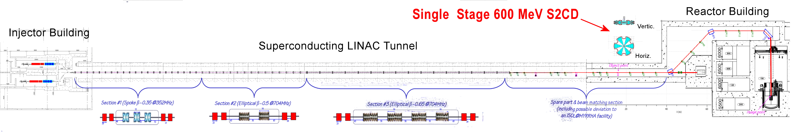
A Cyclotron for ADS
High Reliability:
  Possibility to run the cyclotron with 3 sources; reduced number of components
High Accelerator Power efficiency:
  Efficiency of the proposed Single Stage Cyclotron expected to exceed that of linacs
Maintenance and reparability:
  Beam losses localized mainly at extraction (extraction channel without septum); easier maintenance
Existing experience: PSI, 1.3 MW@0.59 GeV, 94 % reliability (Mike Seidel); several strong focusing design proposals: AIMA (Pierre Mandrillon), Texas A&M, Daedalus
Cost effectiveness linked to compactness
MYRRHA Linac Infrastructure
Notes:
Electron Cyclotron Resonance

Slide 10

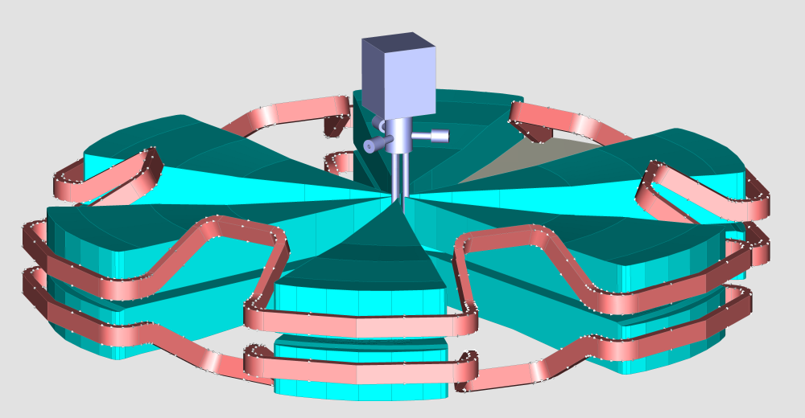


CYCLADS: CYClotron for ADS
Consortium (Single stage, H₂⁺, superconducting)
AIMA Developpement
ASG Superconductors
CERN, ENEA, HNE
INFN Catania & Genova
iThEC
N-21
PSI
Future and Emerging Technologies (FET)
Horizon 2020
Extracted beam energy: 600 MeV (could reach 800 MeV), current: 6 mA
Based on the reverse valley field concept
Superconducting coil current density: 43.5 A/mm²
Extraction radius: 4.5 m
3 injection lines (Pierre Mandrillon)
Notes:
Luciano Cinotti

Slide 11
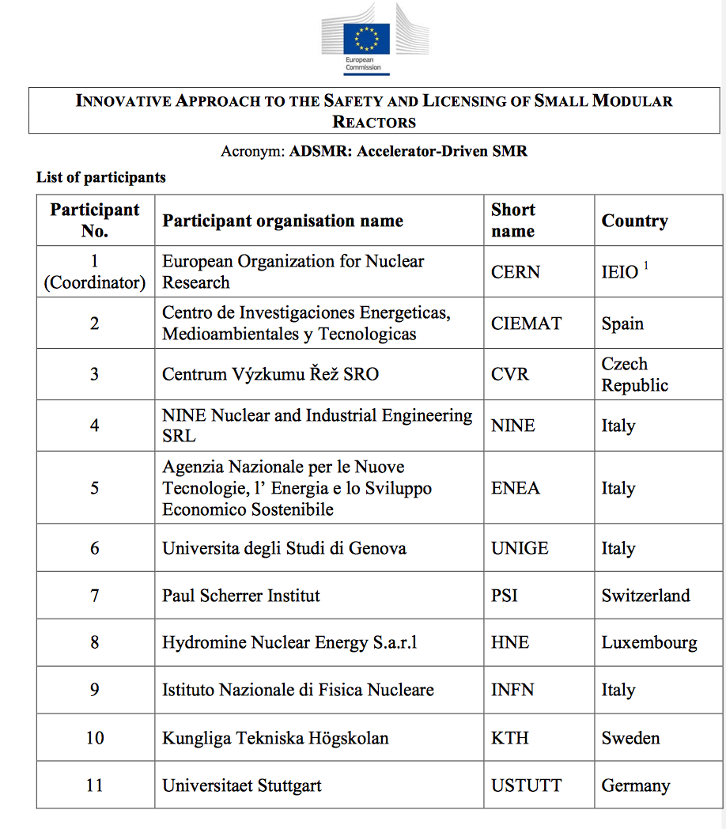
EURATOM proposal
The EURATOM work program 2019 focuses on the safety of nuclear systems, radiation protection, and radioactive waste management.
NFRP-05: Support for safety research of Small Modular Reactors
We enlarged the consortium
Accelerator-Driven SMR: ADSMR
The main objective of the ADSMR proposal is to analyse the Licensing Process (LP) applied to a specific, innovative concept, the Accelerator-Driven Small Modular Reactor (ADSMR).
Notes:
The ambition is to design a competitive system for transmuting HLW and other applications (electricity production at less than 5 cents/kWh).

Slide 12
Next step in ADS
Date | Project | Neutron Source | Core | Purpose
1994 | FEAT [7] (CERN) | Proton: 0.6 to 2.75 GeV (~10¹⁰p/s) | Thermal (≈ 1 W) | Reactor physics of thermal subcritical system (k≈0.9) with spallation source - completed
1995 | MUSE [8] (France) | DT (~10¹⁰n/s) | Fast (< 1 kW) | Reactor physics of fast subcritical system - completed
1997 | TARC [9] (CERN) | Proton: 0.6 to 3.5 GeV (~10¹⁰p/s) | Fast (< 1 W) | Lead slowing down spectrometry and transmutation of LLFP - completed
2001 | TRADE [10] (Italy) | Proton: 140 MeV + Ta (40 kW) | Thermal (200 kW) | Demonstration of ADS with thermal feedback - cancelled
2001 | YALINA [12] (Belarus) | DT (~10¹⁰n/s) | Fast (< 1 kW) | Reactor physics of thermal & fast subcritical system - completed
2002 | SAD [13] (Russia) | Proton: 660 MeV + Pb-Bi (1 kW) | Fast (20 kW) | Coupling of fast subcritical system with spallation source - cancelled
2006 | MEGAPIE [14] (Switzerland) | Proton: 600 MeV + Pb-Bi target (1MW) | ----- | Demonstration of 1 MW target - completed
2006? | TEF-P [15] (Japan) | Proton: 600 MeV + Pb-Bi (10W, ~10¹²n/s) | Fast (< 1 kW) | Coupling of fast subcritical system with spallation source including MA fuel configuration
2006 | TEF-T [15] (Japan) | Proton: 600 MeV + Pb-Bi (200 kW) | ----- | Dedicated facility for demonstration and accumulation of material data base for long term
2010 | GUINEVERE [16] (Belgium) | Deuterons: 250 keV, ≤ 5x10¹⁰ n/s | Fast (small) | Online reactivity monitoring, sub-criticality determination, operational procedures – completed
2018 | U-ADS [17] (Ukraine) | Electrons: 100 MeV 100 kW | Thermal (200kW) | Uranium-based ADS prototype (KIPT) – being commissioned
On going ≥ 2033 | MYRRHA [18] (Belgium) | Proton: 600 MeV + Pb-Bi (1.8 MW) | Fast (60-100 MW) | Under design, not fully funded, accelerator funding approved by Belgium government
On going ≥ 2030 | ADANES [19] (China) | Protons: 0.6 – 1.5 GeV | Fast (100–>1000MW) | Four phase project: 2011 – 2030; second phase approved
ADS projects so far at zero power
Need for a reactor-accelerator coupling experiment at non-zero power already recognized in the EUROTRANS project of the EU 6th Framework Program
“With a view to assisting the design of XT-ADS and EFIT, validated experimental input from relevant experiments at sufficient power (20-100 kW) on the coupling of an accelerator, a spallation target and a sub-critical blanket should be provided. Design input on the dynamics and experimental techniques of such a coupled system with feedback effects, together with shielding, safety and licensing issues will be very valuable.”
Integrated Project EUROTRANS. Annex I-“Description of Work”. Contract no. FI6W-CT-2004-516520 (2005)
Notes:
U0ADS in Ukraine designed as multipurpose neutron source, not for ADS dynamics research

Slide 13
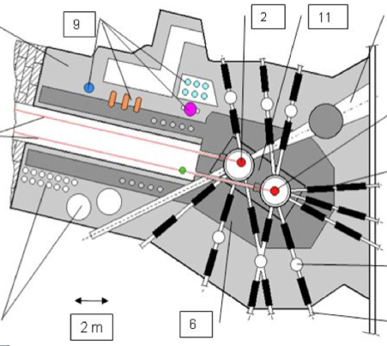
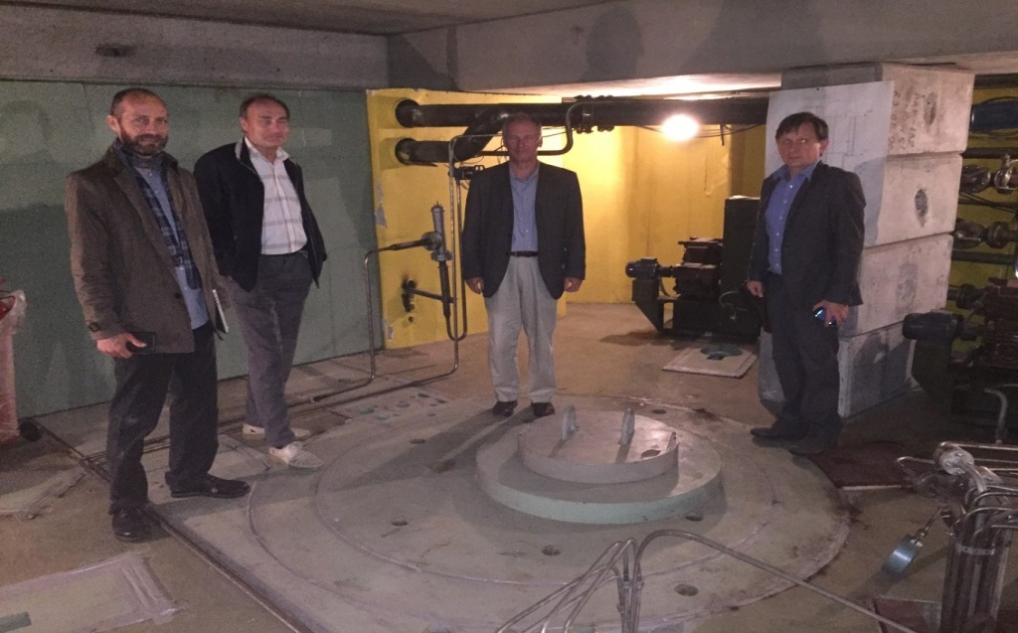
Existing infrastructure at Troitsk
ADS experimental cell
– Proton linac at the Meson Moscow Factory (design: ≤ 600 MeV, ≤ 300kW)
– Spallation neutron source (in operation)
– Pit on a beam line to receive subcritical core
– Infrastructure to manipulate highly radioactive material
– Cooling system and water treatment plant allow dissipating ≤ 30 MW

Slide 14
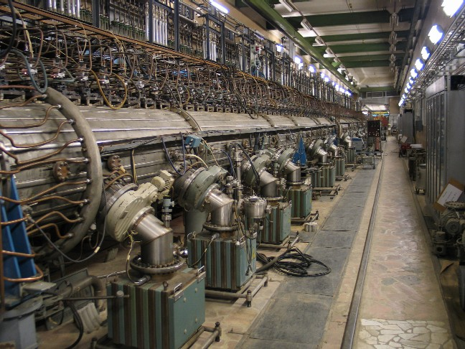
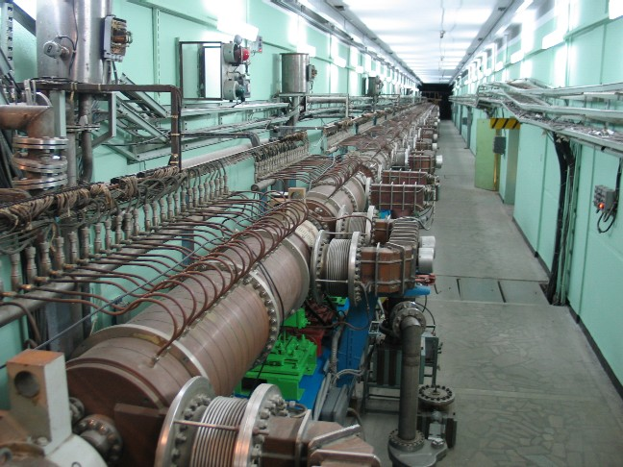

The linear accelerator at Troitsk
720 m
Isotope Production Facility
H⁺
0.75 MeV
100 MeV
160 MeV
247 MeV
423 MeV
602 MeV
Experimental Area
RFQ
C₁
C₅
C₆
C₉
C₁₀
C₁₄
C₁₅
C₂₃
C₂₄
C₃₂
H⁻
Low energy part of accelerator
5 Drift Tube Tanks
Frequency – 198.2 MHz
Output energy- 100 MeV
High energy part of accelerator
27 four-section Disk and Washer cavities
Frequency 991 MHz
Output energy- 600 MeV

Slide 15
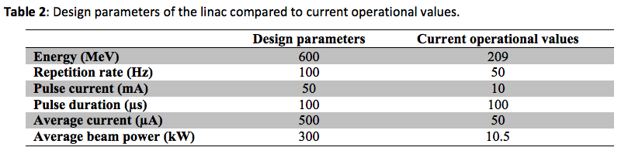
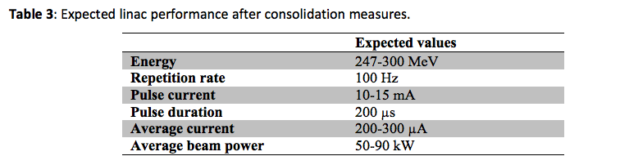
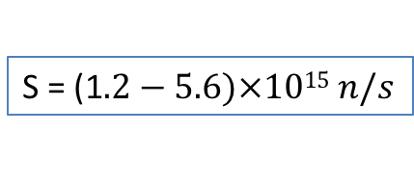
Beam parameters
The linac needs refurbishing to reach desired performance. Current limited by lack of 198.2 MHz high-power triodes. Assuming exchange of the first DAW accelerating structure (suffering from frequent breakdowns) and purchase of additional klystrons to go up to 300 MeV, one can expect the performance shown in Table 3.
400 MeV protons could be envisaged to increase spallation neutron yield at the cost of extra klystrons
S = (1$.2−5.6)×1015 n/s$

Slide 16
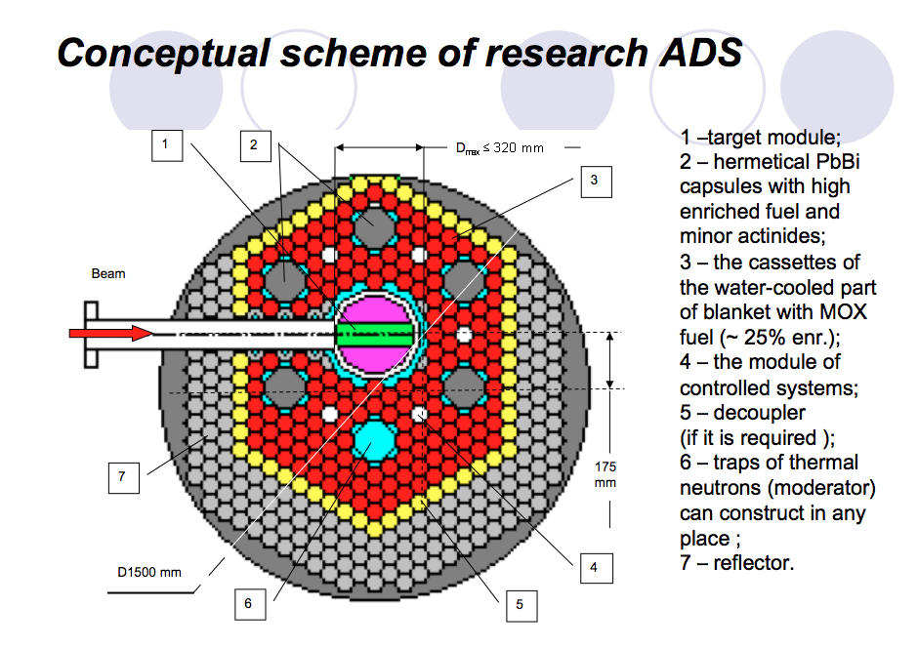
Initial ADS proposal
Stanislav Sidorkin presented a proposal of an ADS experiment at Troitsk [ThEC13 Proc., CERN Globe of Science and Innovation, Geneva, Switzerland (October 27–31, 2013), Springer, Berlin (2016)]
Modules with enriched fuel and MA would be manufactured, tested and studied at the Institute of Physics and Power Engineering in Obninsk, after irradiation at Troitsk.
Notes:
Mostly a test of minor actinide transmutation

Slide 17
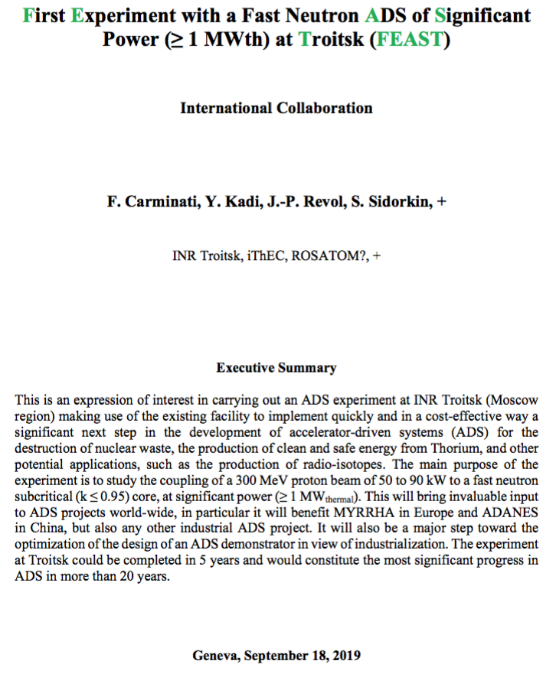
ADS @ INR Troitsk
Studying alternative approach
Main goals
  Characterize the properties of an ADS at non-zero power driven by a pulsed proton beam inducing a thermal core power in a fast/epithermal neutron core of order 1 MW_{th} or above, including on-line reactivity monitoring, predictability of sub-criticality, development and validation of the corresponding simulation;
  Define operational procedures and demonstrate safety;
  Demonstrate macroscopic transmutation of nuclear waste (plutonium, minor actinides, long-lived fissions fragments – ⁹⁹Tc and ¹²⁹I – short-lived fission fragments – ¹³⁷Cs and ⁹⁰Sr);
  Test various thorium-based fuel elements in a fast/epithermic neutron flux;
  Test the production of new radioisotopes of interest for medicine and industry.

Slide 18
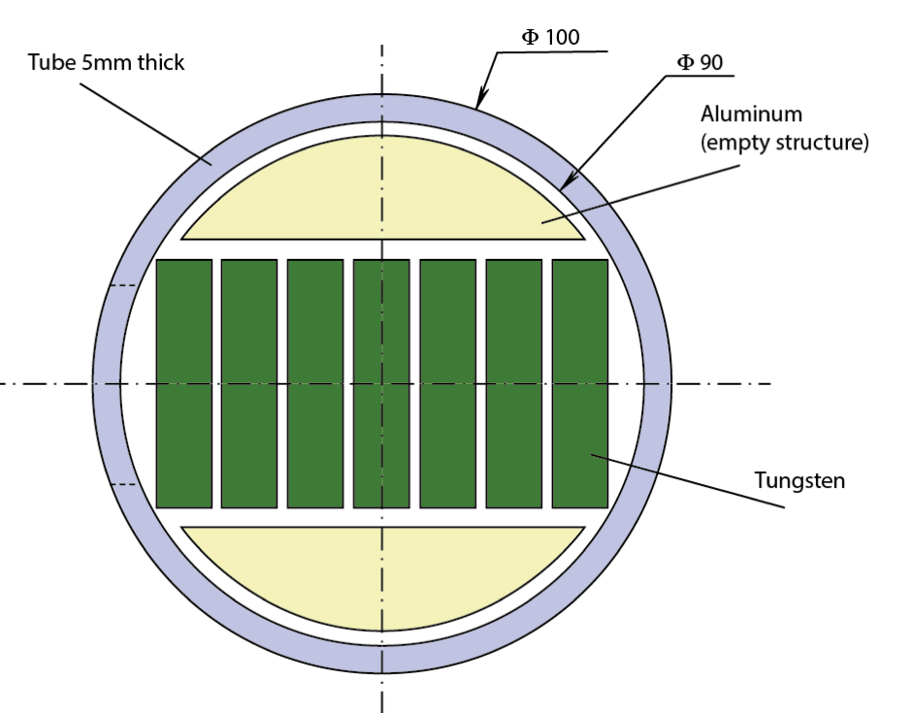
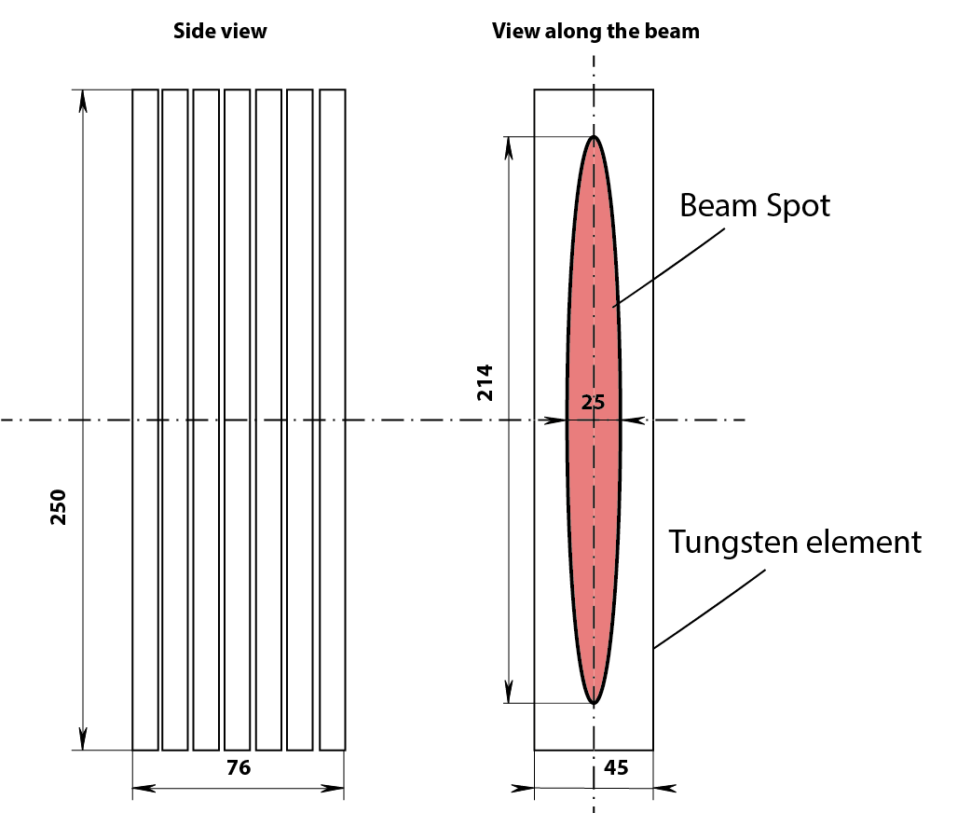
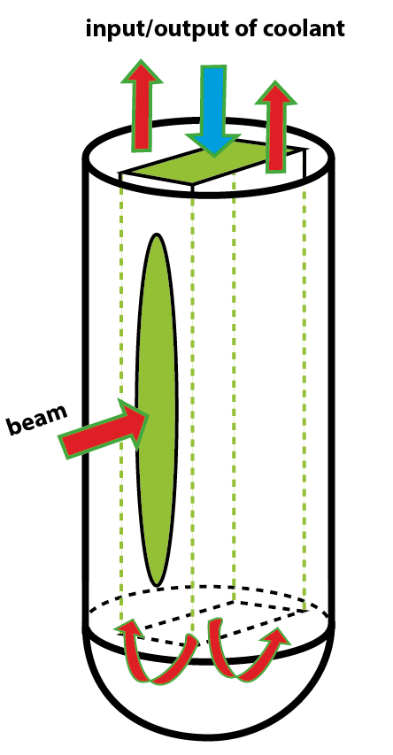
Initial target design
Water-cooled tungsten target, being optimized in order to minimize thermalization
INR already operating such targets for radioisotope production

Slide 19
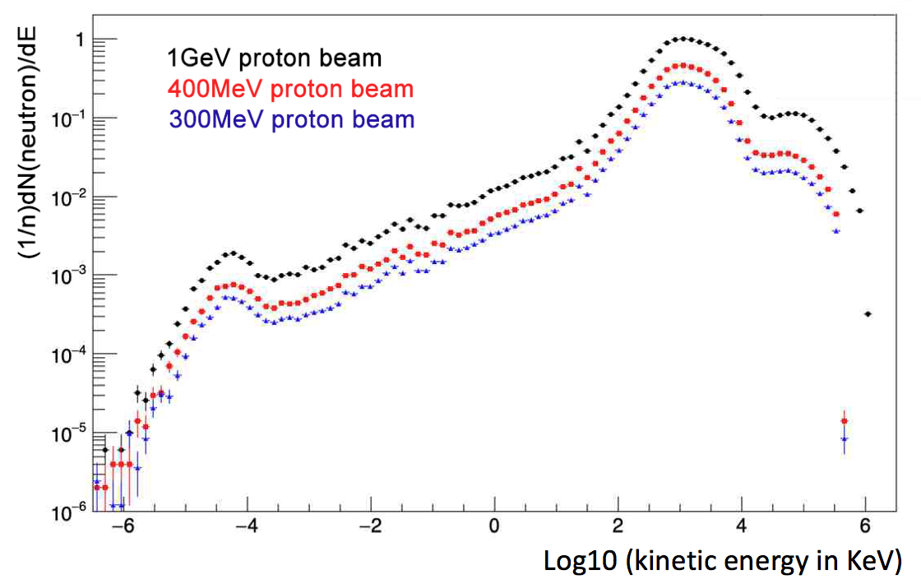
Neutron spectrum out of target
Early simulation results prior to optimization (with target shown in previous slide)
Energy spectrum of neutrons emerging from the tungsten target (David Sangcheol Lee)

Slide 20
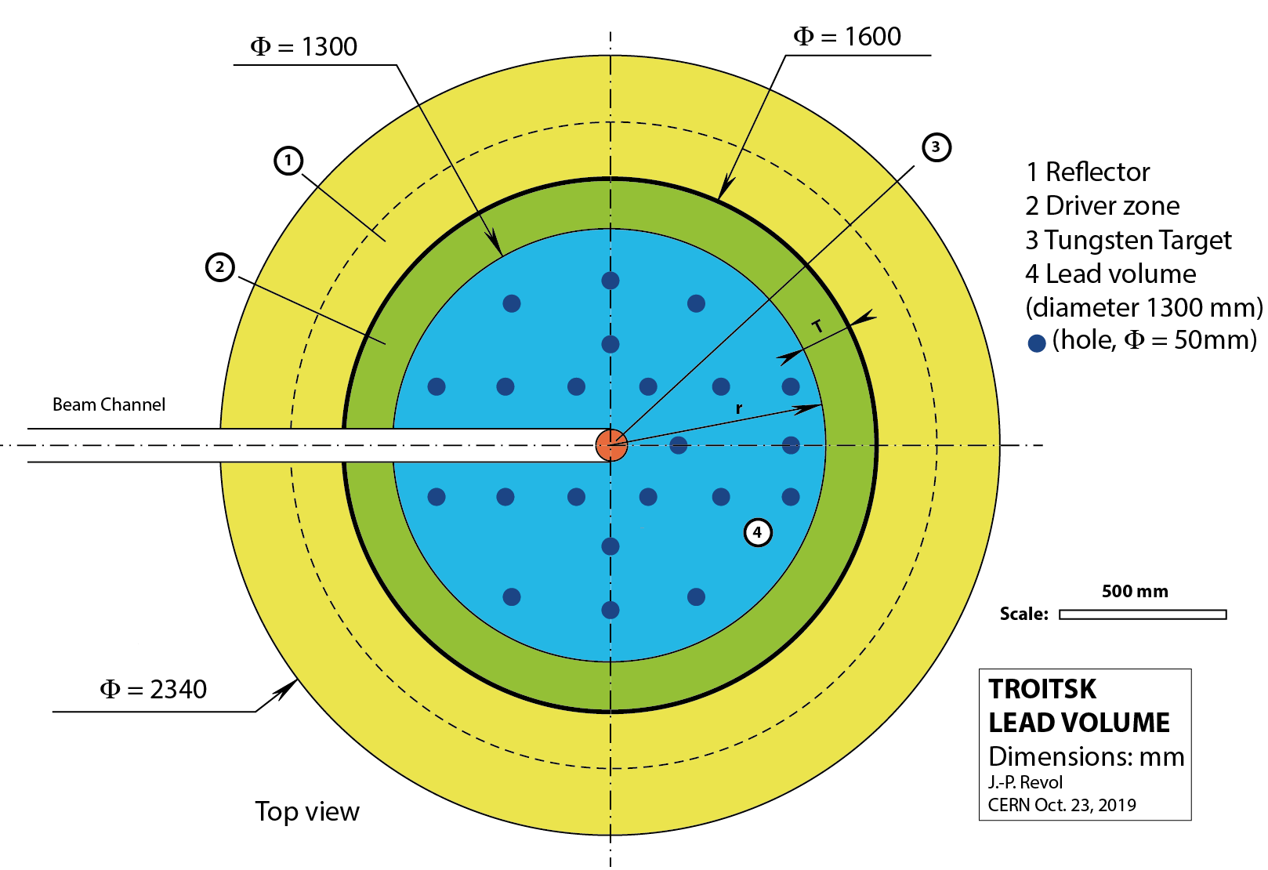
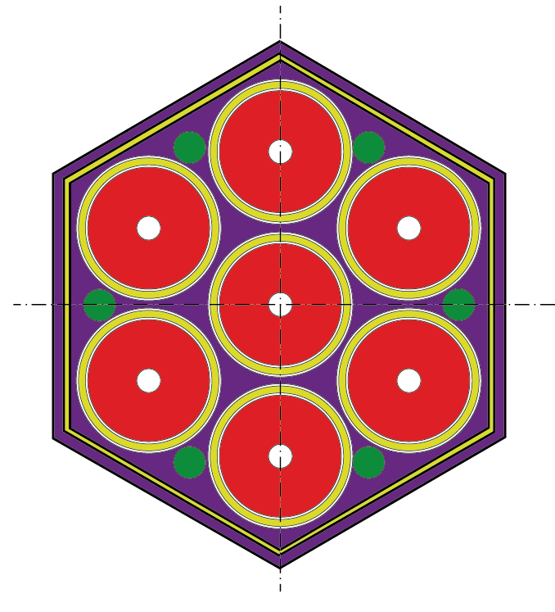
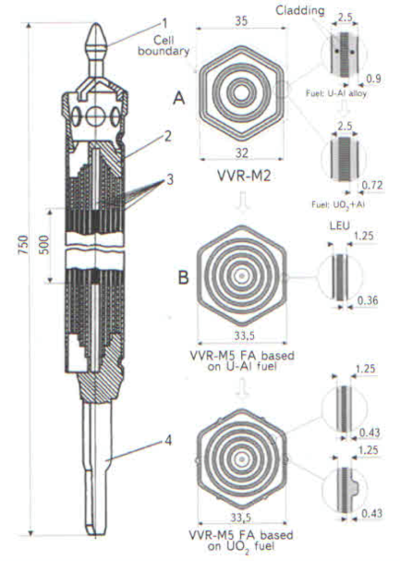
Alternative core concept
  Simplify design to make it cheaper; minimize thermalisation by water
To be engineered and submitted for approval to Russian safety authorities through ROSATOM
Fuel elements availability:
  IBR-2M (PuO₂)
  VVR-M5 (UO₂ or UO₂-Al)
Reflector, already in place

Slide 21
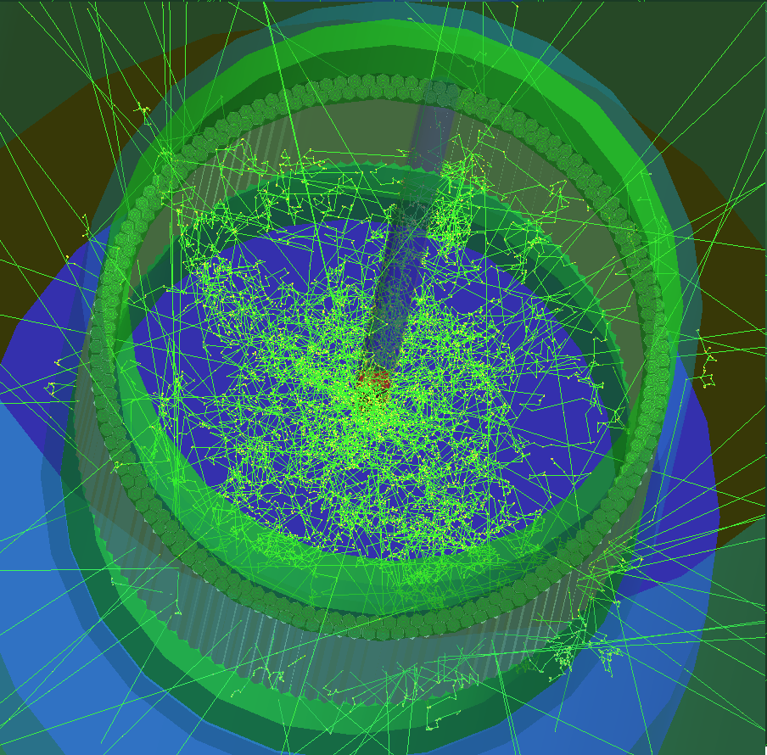
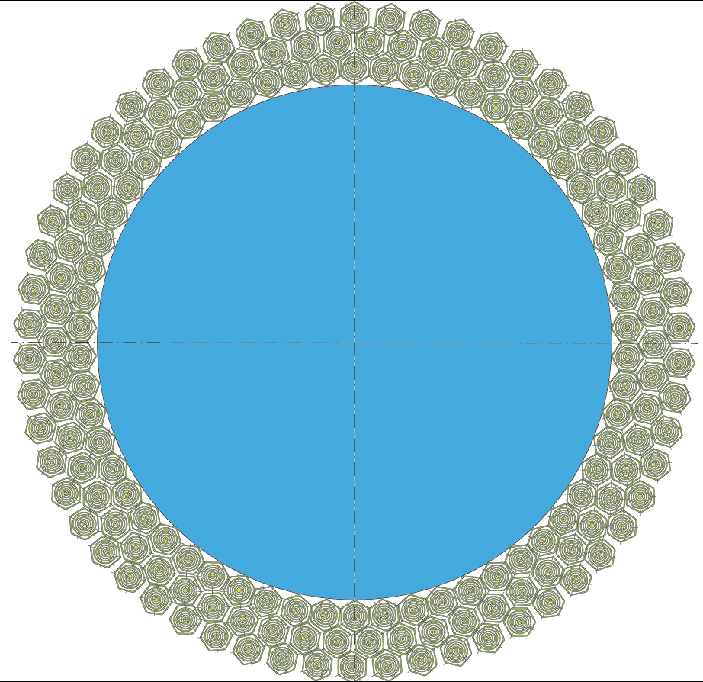
Core simulation
  Using FLUKA and GEANT 4
Example with VVR-M5 fuel elements

Slide 22
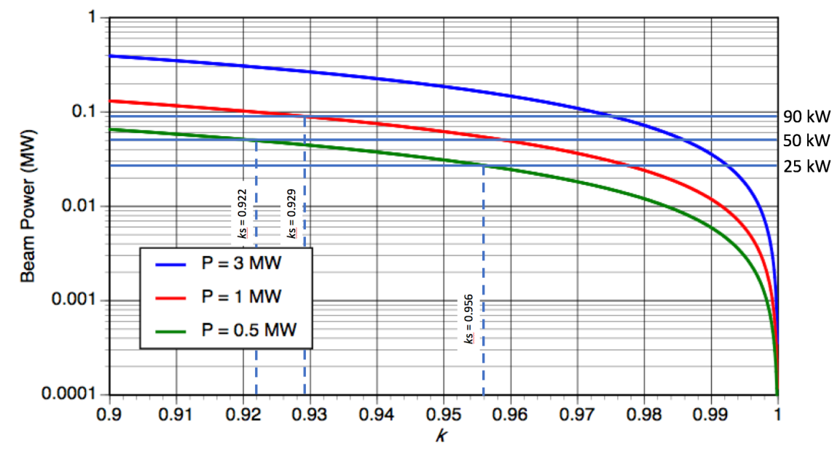
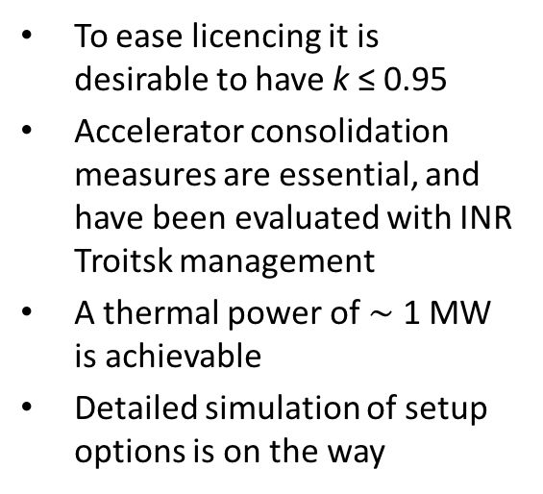
Achievable core power
To ease licencing it is desirable to have k ≤ 0.95
Accelerator consolidation measures are essential, and have been evaluated with INR Troitsk management
A thermal power of $\sim$ 1 MW is achievable
Detailed simulation of setup options is on the way
Discussions between ROSATOM, Kurchatov Institute, INR, RAS and BINP Novosibirsk on the creation of a working group
Interest at CIEMAT (working on core simulation)

Slide 23


CONCLUSION
iThEC’s ambition is to promote ADS with a view to make thorium a sustainable energy source
Progress toward a first coupling experiment
at Troitsk. iThEC welcomes collaboration
iThEC serving as a base for new concrete
ADS projects in the private sector
iThEC congratulates the MYRRHA community for carrying very high the ADS flag

Slide 24
RESERVE SLIDES

Slide 25
Abstract
The international Thorium Energy Committee (iThEC), a non-profit association under Swiss law, created in 2012 to promote research and development in thorium technologies, with the more specific initial goal of destroying nuclear waste in accelerator-driven systems (ADS), and the longer-term goal of exploiting thorium as a sustainable source of energy.
After briefly reviewing the motivations for exploiting thorium, I will describe iThEC’s strategy toward that goal. I will present two main projects, which iThEC is currently actively promoting, a proposal for an ADS experiment at the Troitsk Institute for Nuclear Research in Russia (First coupling of an accelerator with a fast neutron subcritical core, at significant power), and the study of a concept of ADS as an innovative small modular reactors (ADSMR), with emphasis on licensing issues.

Slide 26
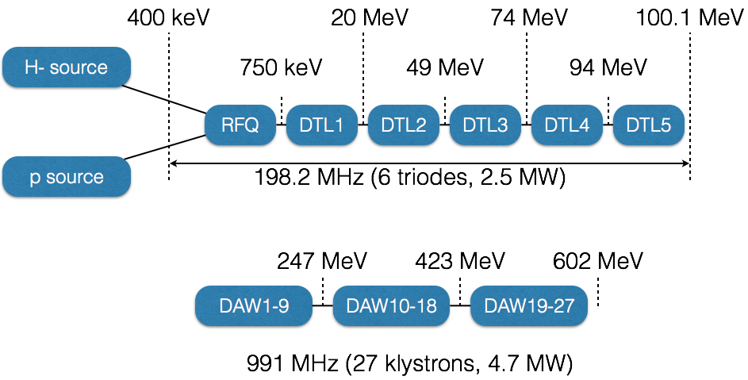
Block diagram of the Troitsk LINAC

Slide 27
Troitsk ADS Road Map
The project will proceed in eight main phases, over a period of 5 years. The first step consists of the preparation of a conceptual design needed for approval of the facility by the Government of the Russian Federation, and the formation of an international collaboration:
  Preliminary phase – Specifications of technical parameters
  Conceptual design
  Obtaining Government authorization, in three steps:
      Declaration of intent
      Estimate of the impact on the environment
      Funding plan
  Technical design
  Licensing
  Permission for construction and installation
  Construction and installation
  Permission for commissioning and operation

Slide 28
Preliminary planning*
The basic stages | Distribution on years from the beginning of funding
 | 1 |  | 2 |  |  | 3 |  | 4 |  |  | 5
Development of the conceptual and draft designs. Choice and substantiation of key parameters and technical decisions. Preparation of requirements specifications on the fuel elements the fuel cassettes the PbBi capsules and target. The project of the window diagnostic system. Examination. The state license for placement.
Detail design of stand. Detail designs of the fuel elements the fuel cassettes the PbBi capsules and the diagnostic systems included to the main units. The co-ordination with State Committee for Nuclear Safety.
Project of State Special Design Institute – SSDI (placement and varies connections of stand, building part). The project of the security guard for nuclear-danger object. The obtaining of the building license for stand.
The working draft (the working drawings of facility).
Production of the equipment, Development testing of PbBi capsules, Building and assembly jobs.
Balancing and commissioning. The obtaining of the license for operation.
The beginning of operation. Stage-by-stage increase of power.
* Courtesy Prof. Leonid V. Kravchuk

Slide 29
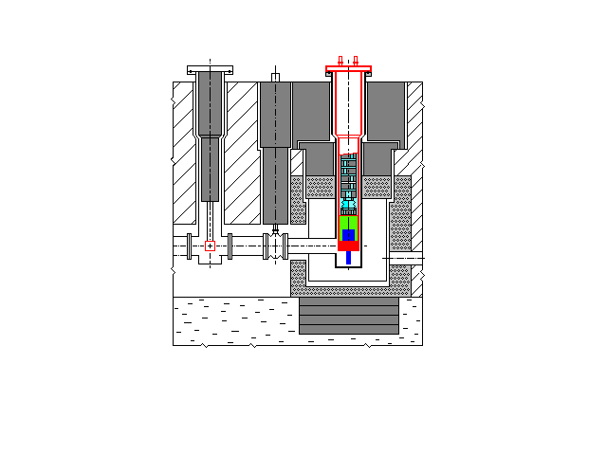
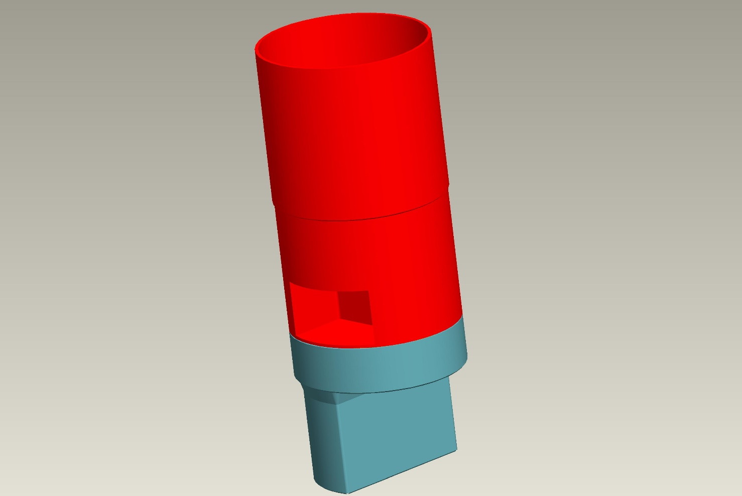
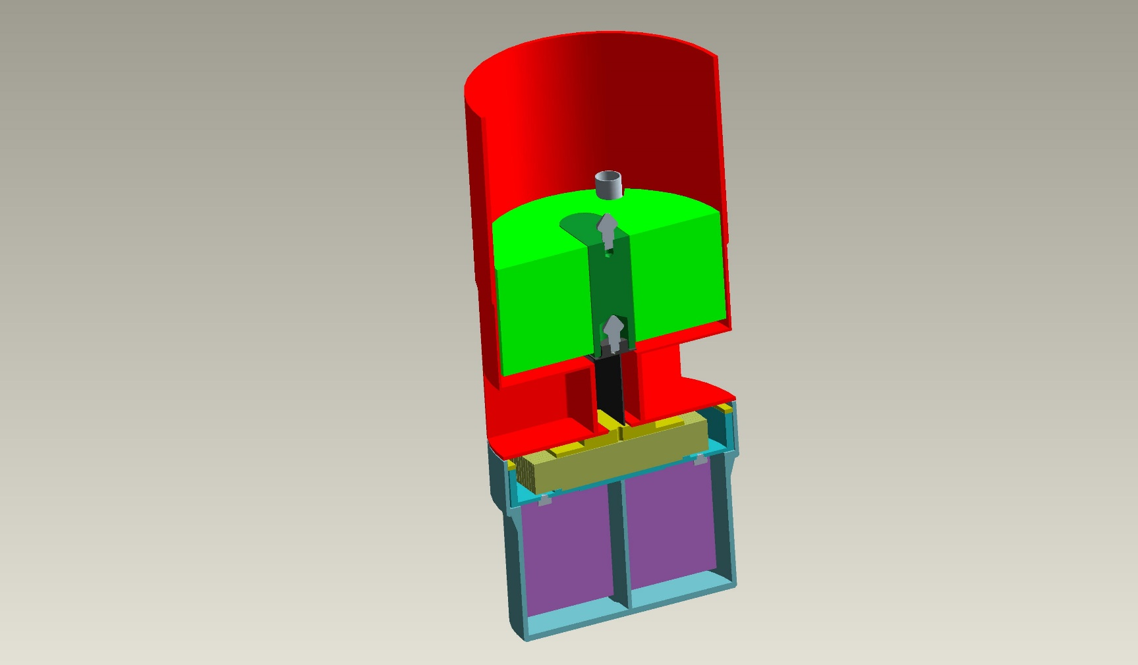
Scheme of the pulsed neutron source with a new module
1
5
8
8
4
2
n
7
3
6
The enlarged lower part of the module containing a target, moderators and reflectors, cut of the lower part of the module.
Position of a target module in the neutron source and the arrangement of basic elements
S. Sidorkin

Slide 30
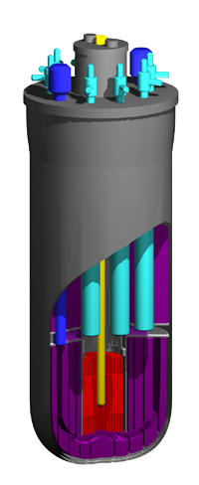
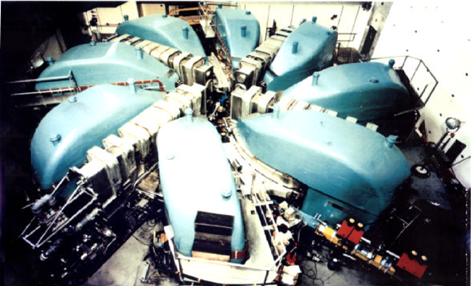
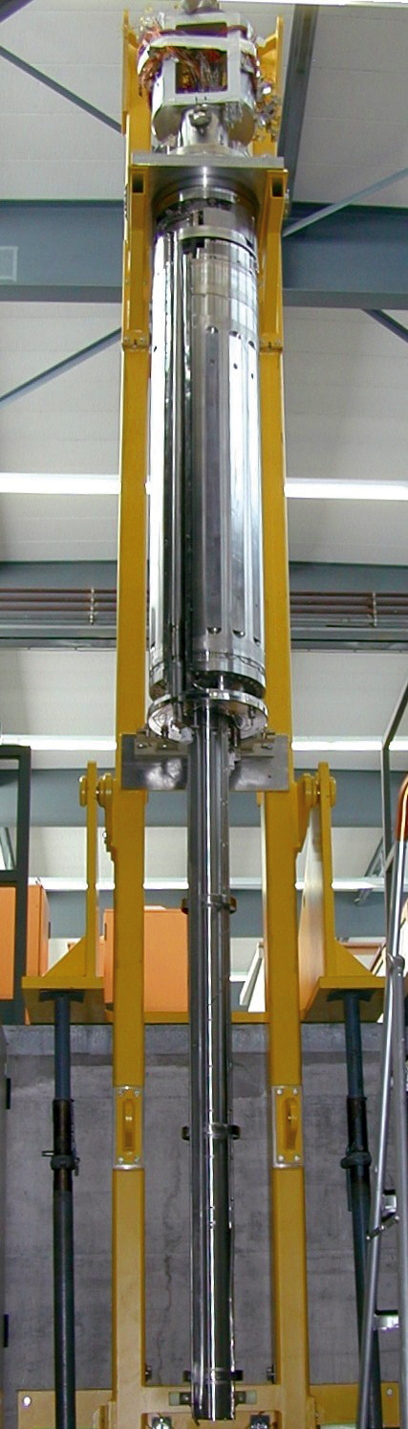
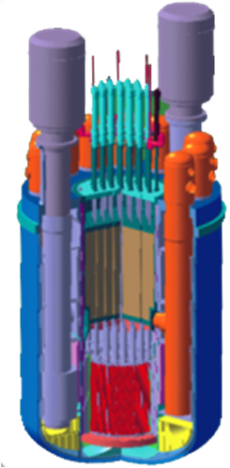
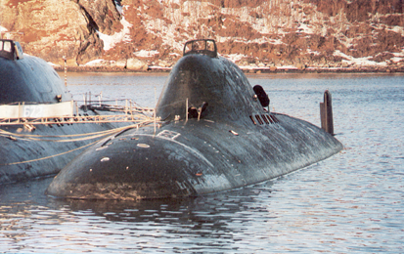
  All basic elements of ADS have now been tested separately
Technology of pyrochemical reprocessing of fuel
High power accelerators technology
UO
2
2+
UO
2
+PuO
2
PuO
2
2+
Technologies of fast reactors
with lead-bismuth coolant
Liquid metal targets technology

Slide 31
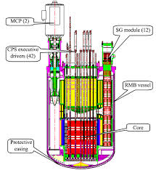
Lead cooled sub-critical reactors
We support the efforts for the development of molten lead or lead-bismuth eutectic as coolant. Excellent thermodynamic properties with low-pressure, chemically stable liquids.
  The SVBR-100 reactor(Pb-Bi cooling) was in development in Russia, now in China
  The BREST-OD-300 reactor (Pb-cooling) in Russia. More experiments and tests are required from regulatory authorities.
Reference designs, apart from the necessary modifications required by the positioning of a lead-bismuth target.
Reactor monobloc vessel of SVBR-100
.

Slide 32
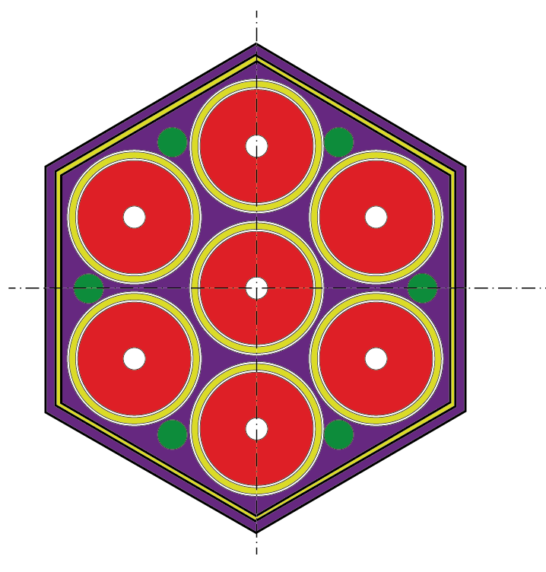
Fuel element
IBR-2M

Slide 33
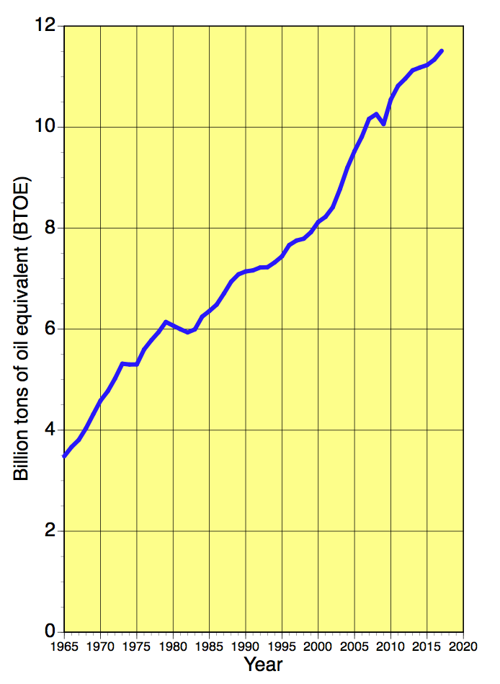
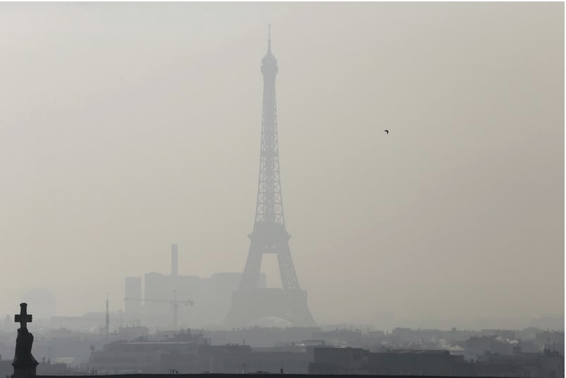
Kill 2 rabbits with 1 stone:
– Fight air pollution
– Fight global warming
World consumption of fossil fuels
coal + oil + gas = 85% of total (2018)
A huge challenge!
BP Statistical Review of World Energy 2018
Notes:
Fossil fuels: convenient, cheap, they allowed us to develop as far as we did
Today, the trouble makers of the world: (wars, atmospheric pollution, global warming, and in any case finite resource
Not sustainable
A formidable challenge to replace 85% of energy production
Requires systematic approach, a truly disrupting technology

Slide 34
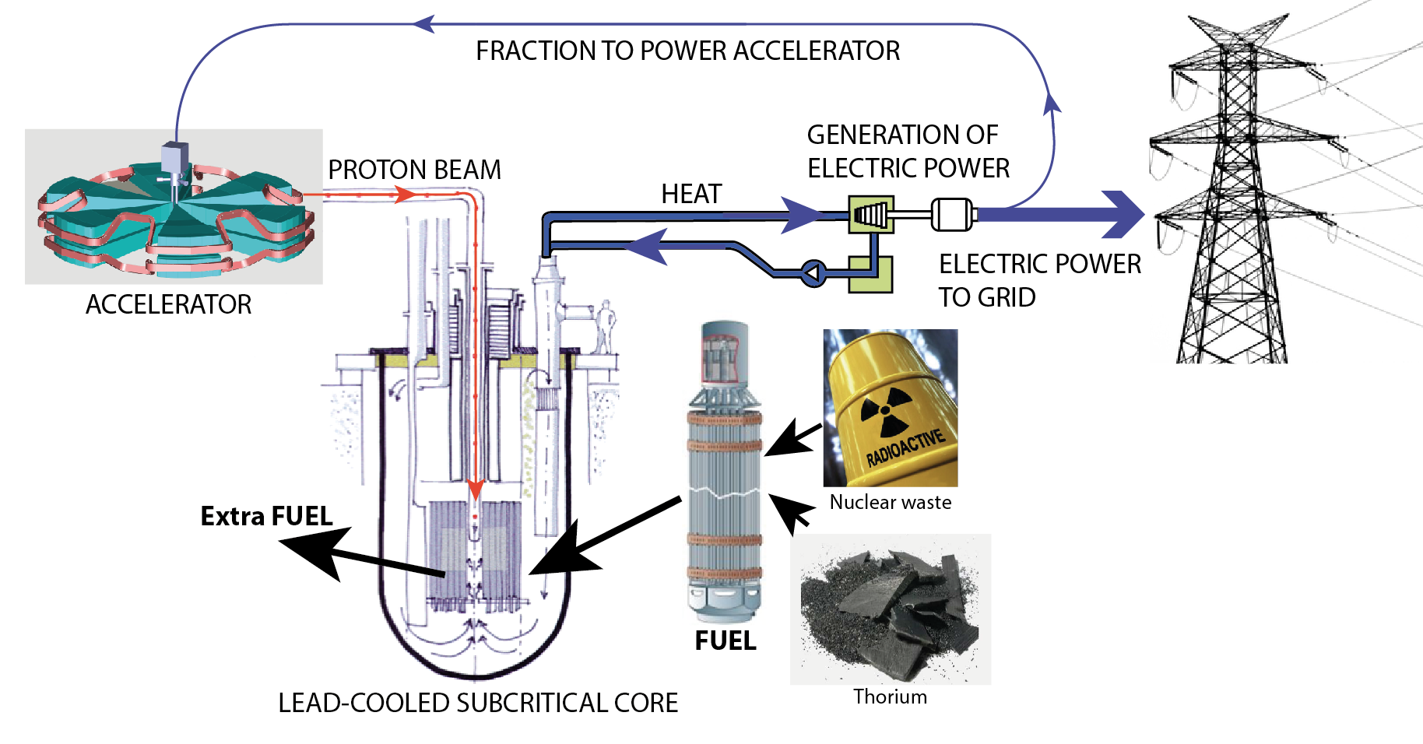


Technology from research in particle physics
(CERN, PSI, Fermilab, etc.)
Notes:
The idea to use a proton accelerator is not new, but today the technology is ready
Developed in laboratories such as CERN, with a significant history of feeding innovation
First PET scanner built by CERN in early 1880s, all medical imaging comes from particle physics,
and what was more disrupting that the World Wide Web invented at CERN in the past 20 to 30 years?
Technology validated at CERN, through the work initiated by Nobel laureate Carlo Rubbia to destroy nuclear waste and produce safe and clean energy

Slide 35
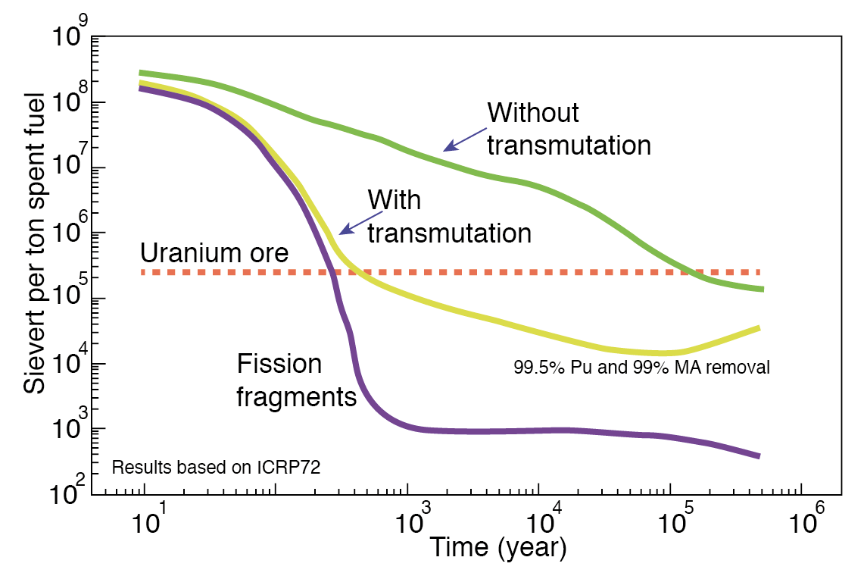
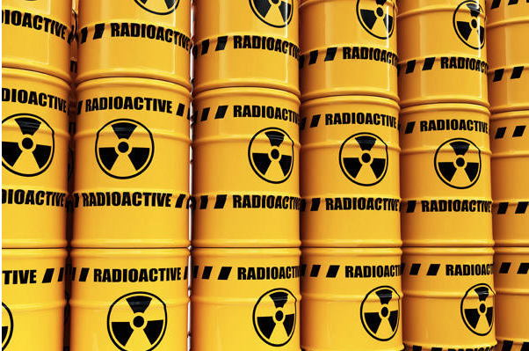
Destruction of nuclear waste: an alternative to long-term storage
Ingestion radiotoxicity of spent nuclear fuel
150000 years
300 years
Notes:
Nuclear waste management is an unsolved problem, whether countries decide to stop nuclear power, to continue nuclear power, or to deploy nuclear power
The possibility exist to destroy long-lived nuclear waste as an alternative to long-term storage, which is the only solution advocated by nuclear industry
It is possible today to reduce the dangerousness of nuclear waste, well below that of the uranium ore that produced it
The investment that is needed to destroy nuclear waste will make thorium energy available faster and at a competitive price

Slide 36
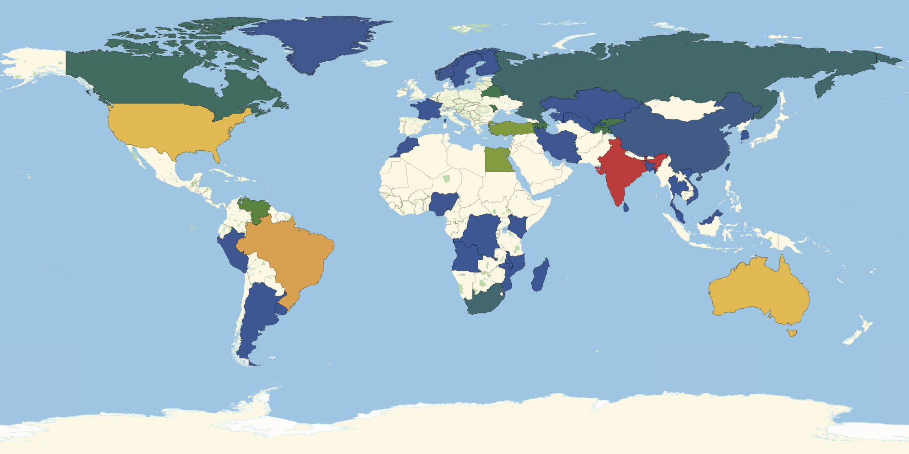
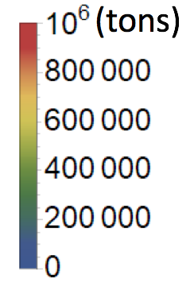
Thorium: powering the planet for the next 2000 years
No thorium information
Notes:
Thorium is a resource with potential at least 500 times that of uranium
It is broadly distributed in the world
Countries in which are countries where the information is missing, so presently estimated reserves at 6.3 million tons (OECD/IAEA/Uranium 2014), are likely underestimated
So thorium can be considered as a sustainable source of energy

Slide 37

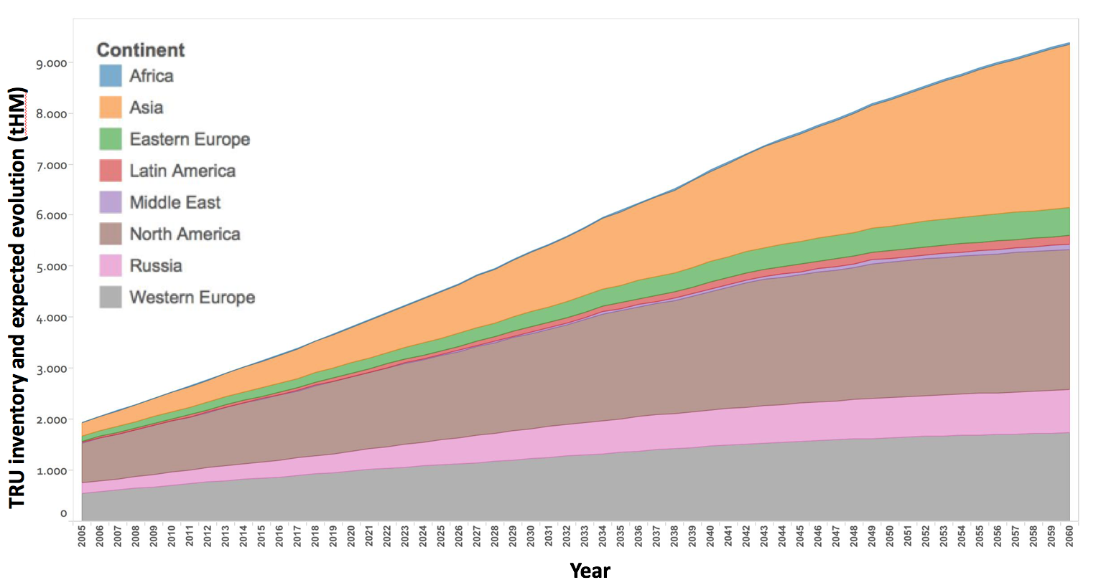
Accumulation of long-lived nuclear waste
2018
(3670 tons)
Source N-21 – Based on historic data and on committed/planned/under-construction and scheduled shutdown plans per NPP
Notes:
Within 40 years, it will have increase by a factor 3
1 ton of TRU would allow to power a 1 GWe power station for one year

Slide 38
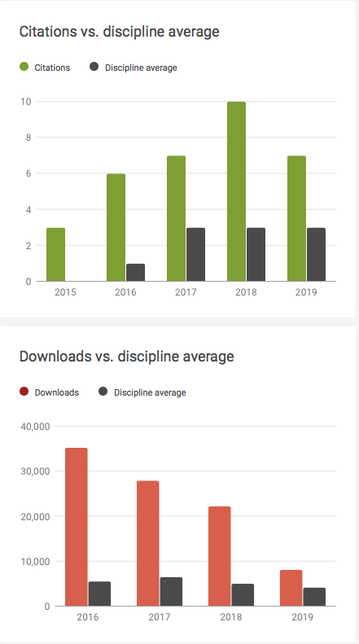
98190 downloads on October 30th
Notes:
European Commissioner for Research, Science and Innovation: Carlos Moedas

