Slide 1

www.ithec.org
17, rue François-Dussaud, 1227 Acacias-Genève, Suisse
Jean-Pierre Revol
CERN, June 13, 2016

Slide 2
iThEC
international Thorium Energy Committee: not for profit association, under Swiss law, founded in 2012: engineers, scholars, politicians and other concerned citizens acting to promote R&D on the use of thorium in order to:
  Transmute nuclear waste
  Produce safe, clean and abundant energy, in particular in view of the huge needs of developing countries
14 nationalities represented in iThEC, strong CERN base (15 CERN staff or retired from CERN) Carlo Rubbia (President d’Honneur), Claude Haegi (FEDRE, former President of the Geneva Conseil d’Etat), Maurice Bourquin (Former Rector of UNIGE, former President of the CERN Council), …
First task for iThEC: Organize the Thorium Energy Conference 2013 (ThEC13)
  ThEC13: Globe of Science and Innovation (Proceedings: “Thorium Energy for the World” – Basic reference on Thorium R&D, Springer)
Notes:
FEDRE: Fondation européenne pour le développement durable des régions

Slide 3
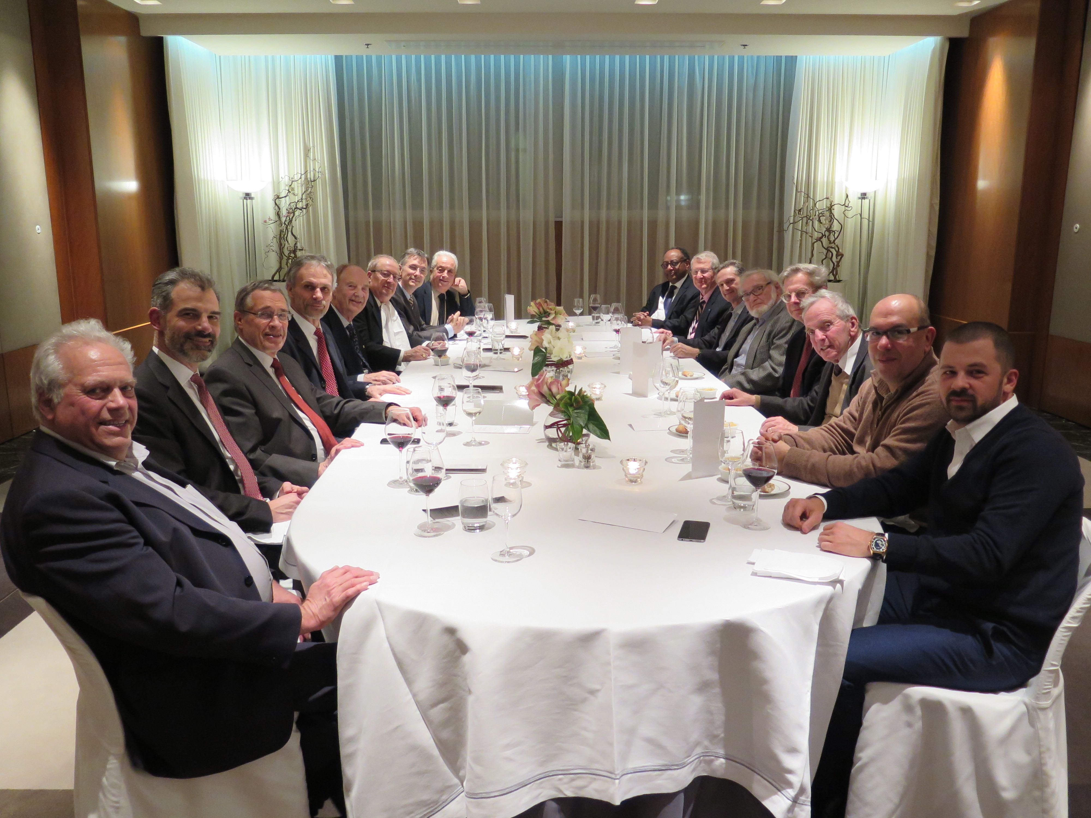

Slide 4
iThEC’s motivations

Slide 5
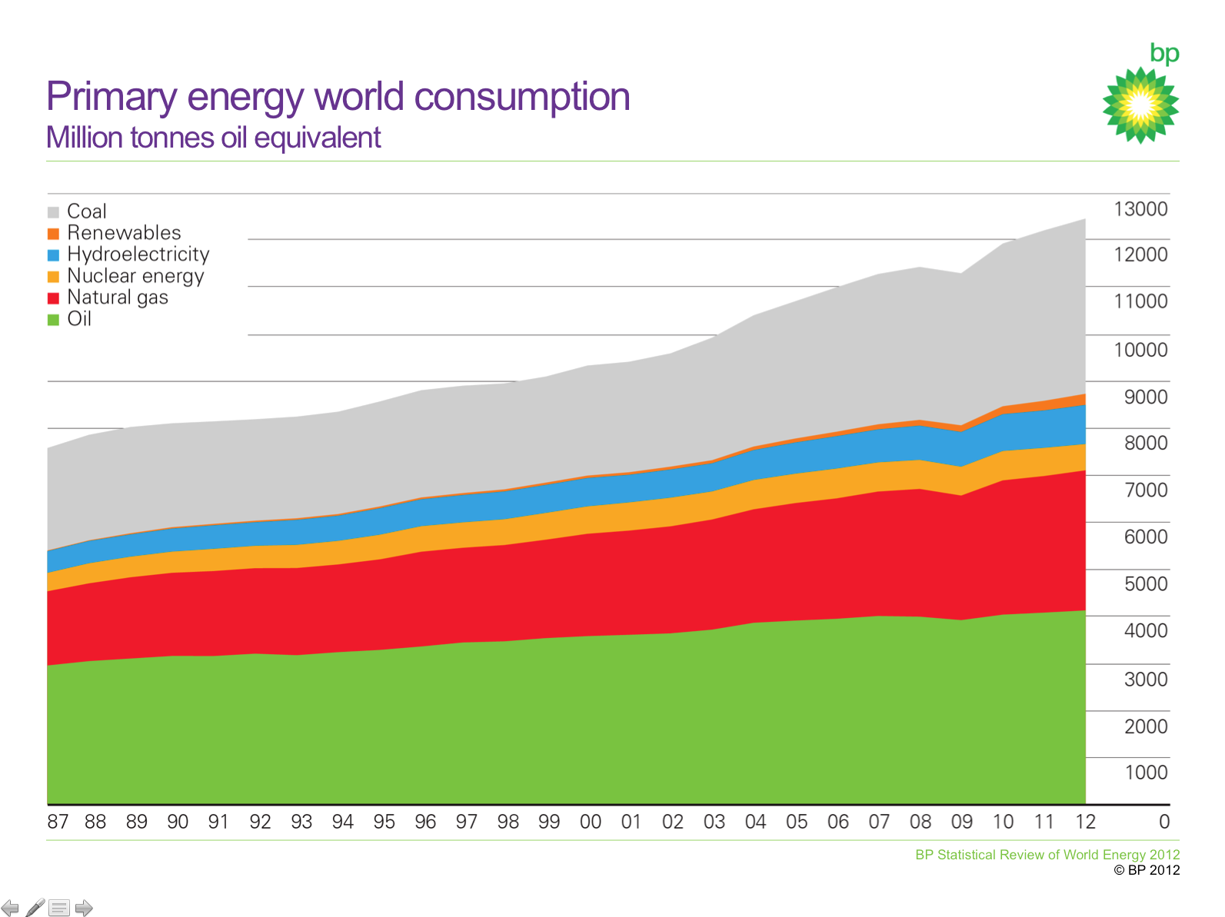
BP Statistical review of World Energy 2014
Renewables
Nuclear
Hydro
2.2%
4.4%
Fossil
6.7%
Coal
86.7%
Gas
Totally dominated by fossil fuels
Not sustainable, even at today’s level of energy consumption
Oil
If, by end of the 21st century, people in developing countries are allowed to live as well as we do in Europe today,
then, the world power consumption will have to increase by a factor 3 or more.
Europe is not representative of the entire world: Globally, 1.1 billion people do not have electricity.
Notes:
Professor Hans Rosling www.gapminder.org
11 billions inhabitants on the planet by 2100;
– 2 billion children since 2000
– 3 billion people more just by filling up adult groups
– 1 billion because by 2100 people will live a bit longer
Africa multiplying by 4 by 2100!!
Not only fossil fuel will progressively disappear but the overall energy consumption will have to increase by a spectacular factor!
+ 2% between 2012 and 2013

Slide 6
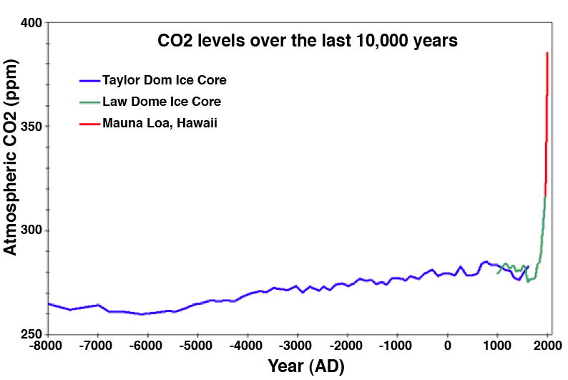
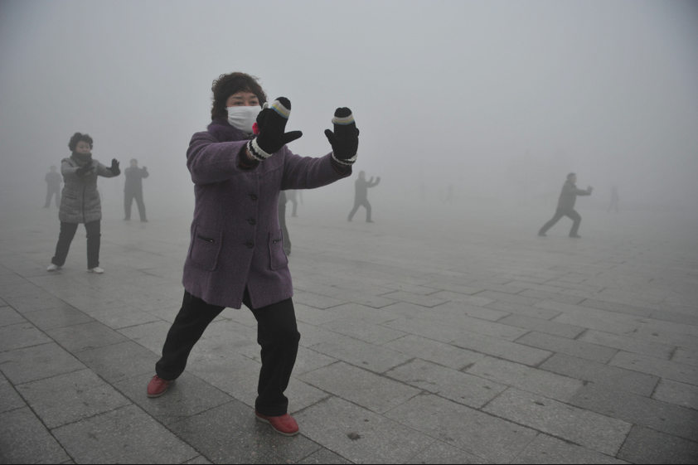
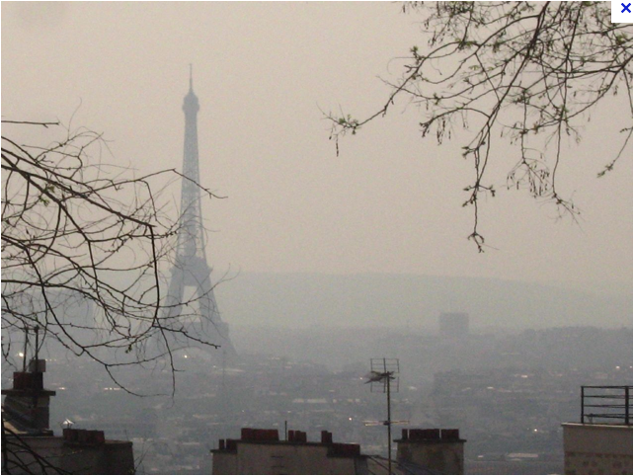
Burning fossil fuels till the end?
Global warming
– Difficult for the public to perceive the danger of something that will happen in the future
Air pollution is with us today
  Burning coal costs Europe alone 40 billion Euros in annual health care expenses
  WHO: 1 in 8 of total global deaths is the result of air pollution exposure
The current tendency is still to increase the consumption of fossil fuels!
Notes:
According to Bloomberg New Energy Finance, Europe spent 600 billion Euros on renewable energies, from 2005 to 2013 (750 years of CERN budget!)
We do not pretend that thorium is THE solution to the energy problem, but it has the potential to make a significant contribution
Autumn 2011: 40 consecutive days with no wind in Germany
Fritz Vahrenholt, “The Neglected Sun”, published by Stacey International
Difficult to tell 1.1 B people to save energy and to not use coal when they do not have electricity!

Slide 7
Solutions must come from R&D
Politicians are stuck because they cannot invent solutions. It is the responsibility of the Scientist to propose new options through R&D.
R&D must be systematic, without prejudice, so there must be R&D also in the nuclear domain.
This is precisely what iThEC is proposing:
  Promoting R&D in nuclear energy based on thorium
  Promoting more specifically developments made at CERN, in nuclear physics, accelerator technology, neutron spallation sources, simulation, and Accelerator-Driven Systems (work of Carlo Rubbia on the Energy Amplifier)
ADS represents the most efficient way to use thorium

Slide 8
20 years history of ADS
√
  Phase 1: ADS basic concepts were developed at CERN –
  FEAT, TARC/CERN patent), neutron crosss section data (n_TOF), simulation tools (FLUKA, EA-MC, GEANT4)
  Phase 2: All basic elements of ADS have now been tested separately – (spallation neutron source (MEGAPIE/1MW at PSI), development of high power targets (EURISOL DS/5MW at CERN), SNS, ESS, R&D on high-power accelerators (IPHI, SPL, LINAC4, high-power superconducting RF structures (SRF), etc.)
  Phase 3:
    Coupling of a beam to a subcritical core at significant power (≥ 1 MW);
    Development of a high-power proton beam adapted to ADS
  iThEC identified a unique opportunity to implement phase 3
√
iThEC activities are centred on phase 3 – two projects

Slide 9
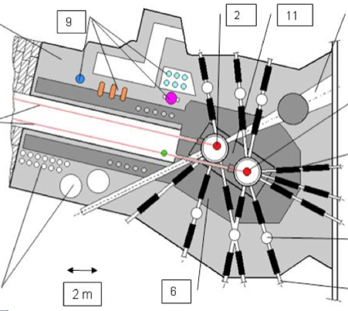
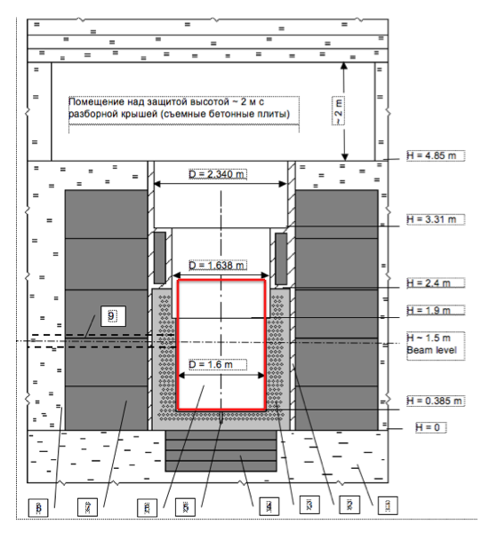
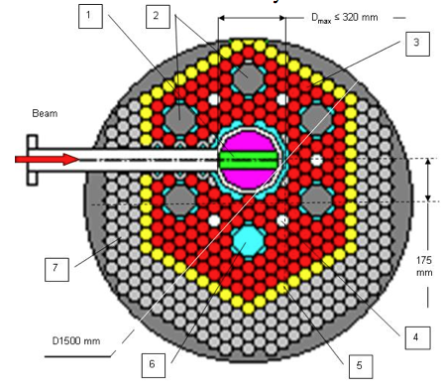
Existing infrastructure at INR Troitsk
FIRST iThEC PROJECT
Fast and at moderate cost
Free
ADS experiment goals:
Measure physical properties of a ≥ 1 MW ADS (coupling accelerator to core; demonstrate safety)
Demonstrate transmutation of nuclear waste
(MA & LLFP/TARC)
Provide unique fast neutron test facility, test the production of specific radioisotopes

Slide 10
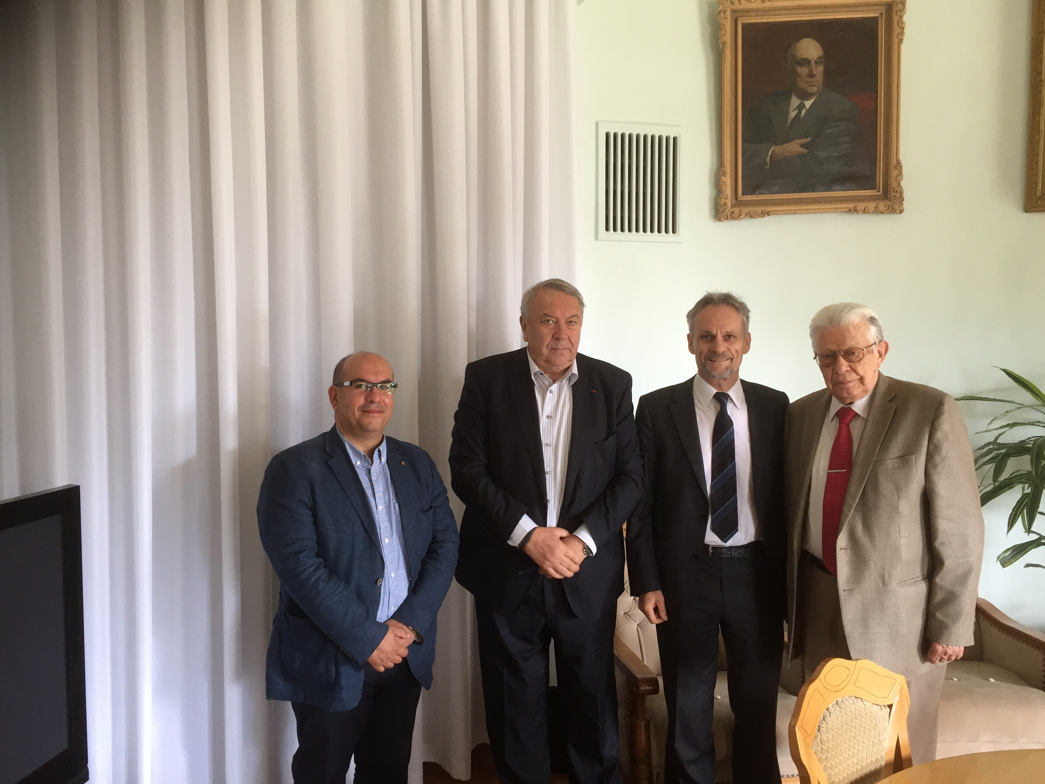
ADS Experiment at INR Troitsk
Review of Troitsk infrastructure by iThEC experts confirmed the feasibility of the project, roadmap prepared by INR* et iThEC
Positive feedback from the Russian Academy of Sciences (RAS), from Russian authorities, who would like to see international support for the project.
Collaboration :
  INR Troitsk, Institut Kurchatov, ROSATOM, and other
  Russian institutes, PSI (Reactor Department), Řež,
  Czech Republic, interest in India, China and South Korea
  Contacts with IAEA to set up a Coordinated Research
  Programme (CRP ) on the project
We would like CERN to help
  Setting up a collaboration on the CERN
  collaborative model (Collab. Agreement)
  Access to CERN expertise, host students
  and Postdocs, etc.)
  Getting eventually the status of recognized
  experiment
* INR Troitsk already in various CERN projets (ALICE, Accelerator, etc.)
Notes:
Mikhail Kovalchuk, brother of Yuri
CSNS construction site located at Dongguan, Guangdong province. It is about 85 km from Guangzhou and about 125 km from Hong Kong.
FASO : Federal Agency of Scientific Organisations of the Russian Federation

Slide 11
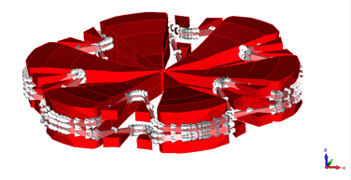
High-power superconducting cyclotron
SECOND iThEC PROJECT
EU Call: "Future and emerging technologies shall support collaborative research in order to extend Europe’s capacity for advanced and paradigm-changing innovation. It shall foster scientific collaboration across disciplines on radically new, high-risk ideas and accelerate development of the most promising emerging areas of science and technology as well as the Union wide structuring of the corresponding scientific communities.”
Project: Conceptual design of a superconducting one stage H₂⁺, cyclotron with 3 injections, 600 MeV, 6 mA, high electrical efficiency (> 40%)
Applications: ADS, high flux particle beams, radioisotopes for medicine, various other industrial applications
Collaboration: iThEC, PSI, AIMA*, ASG, Ing. Cinotti, + others, CERN?
* P. Mandrillon, Centre Lacassagne, Nice
Notes:
ASG: Luca Malacasa, Antonio Pelechia

Slide 12
CONCLUSION
iThEC has a clear but challenging programme, addressing one of the most critical problems of Society
iThEC’s activities are in the spirit of a continuation of developments born at CERN
The ADS experiment at Troitsk and the development in parallel of an innovative high-power cyclotron should contribute to significant progress in the field of ADS and the exploitation of thorium
Getting these two major projects approved is the priority of iThEC
We need support from the physics community
You are all welcome to join iThEC in this great adventure.
See www.ithec.org

Slide 13
History of ADS projects
Project | Neutron Source | Core | Purpose
FEAT (CERN) | Proton (0.6 to 2.75 GeV) (~10¹⁰p/s) | Thermal (≈ 1 W) | Reactor physics of thermal subcritical system (k≈0.9) with spallation source - done
TARC (CERN) | Proton (0.6 to 2.75 GeV) (~10¹⁰p/s) | Fast (≈ 1 W) | Lead slowing down spectrometry and transmutation of LLFP - done
MUSE (France) | DT (~10¹⁰n/s) | Fast (< 1 kW) | Reactor physics of fast subcritical system - done
YALINA (Belorus) | DT (~10¹⁰n/s) | Fast (< 1 kW) | Reactor physics of thermal & fast subcritical system - done
MEGAPIE (Switzerland) | Proton (600 Me) + Pb-Bi (1MW) | ----- | Demonstration of 1MW target for short period - done
TRADE (Italy) | Proton (140 MeV) + Ta (40 kW) | Thermal (200 kW) | Demonstration of ADS with thermal feedback - cancelled
TEF-P (Japan) | Proton (600 MeV) + Pb-Bi (10W, ~10¹²n/s) | Fast (< 1 kW) | Coupling of fast subcritical system with spallation source including MA fuelled configuration – on-going
SAD (Russia) | Proton (660 MeV) + Pb-Bi (1 kW) | Fast (20 kW) | Coupling of fast subcritical system with spallation source - cancelled
TEF-T (Japan) | Proton (600 MeV) + Pb-Bi (200 kW) | ----- | Dedicated facility for demonstration and accumulation of material data base for long term – on-going
MYRRHA (Belgium) | Proton (600 MeV) + Pb-Bi (1.8 MW) | Fast (60 MW) | Experimental ADS – under design
CADS (China) | Protons (0.6 – 1.5 GeV) | Fast (100–>1000MW) | Four phase project: 2011 – 2031
U-ADS (Ukraine) | Electrons | 200 kW | Uranium-based ADS prototype (KIPT)
ADS (Russia) | Protons (250-500 MeV) | 1-5 MW | Using an existing facility at Troitsk

Slide 14
Troitsk Road Map
0– Preliminary phase (6 months)
  Specifications of technical parameters
1– Conceptual design
2– Obtain government authorization, which requires three steps:
  Declaration of intent
  Estimate of the impact on the environment
  Funding plan
3– Technical design
4– Licensing
5– Permission for construction and installation
6– Construction and installation
7– Permission for commissioning and operation
Phases 0 to 7 over 5 years
Cost estimate: 55 M$

Slide 15
Documents available
Executive summary of Troitsk Project
  A MW-class ADS Demonstrator at the Troitsk site of the Institute for Nuclear Research, RAS, Moscow
Troitsk visit report by iThEC experts
  Visit of the Institute for Nuclear Research (INR) of the Russian Academy of Sciences, at Troitsk, by a delegation from the international Thorium Energy Committee (iThEC) and IBeL
Technical and political arguments in favour of an ADS experiment atTroitsk
  Selective TEchnology Platform: A Russian demonstrator for selecting transmutation technologies
ThEC13 Proceedings
  « Thorium Energy for the World » published by Springer
Specifications for the accelerator for the H2020 FET Call
  Technical description of H2020 call elements
Description of Troitsk infrastructure, and strategy for the core
  Technical description and strategy for the ADS experiment at Troitsk (in preparation)

